Slide 1
Extending Rich Text Editor in Umbraco CMS
Wojciech Szubryt
wojciech.szubryt@intive.com
Wrocław, 22.02.2017

Slide 2
Agenda
TinyMCE
TinyMCE in Umbraco CMS
Custom plugin for RTE
Demo

Slide 3
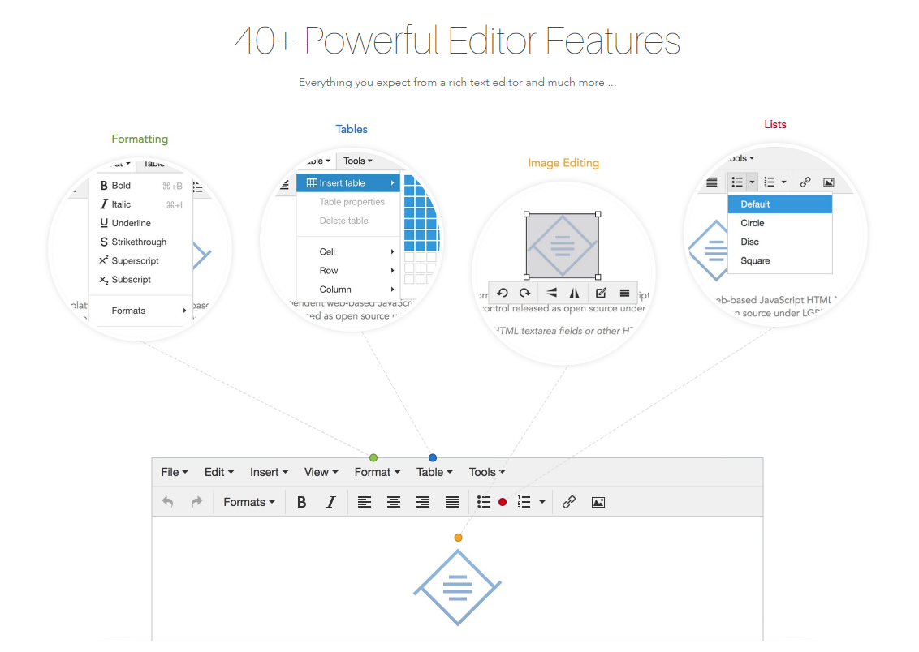
TinyMCE
Source: https://www.tinymce.com/features/

Slide 4
TinyMCE in Umbraco CMS
tinyMceConfig.config file
Be aware of Umbraco.PropertyEditors.RTEController parsing
Notes:
The configuration you set here will be used by each TinyMce instance as it is initialized in Umbraco.

Slide 5
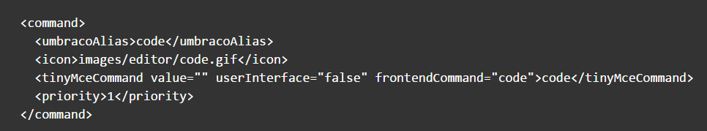
TinyMCE in Umbraco CMS – Commands
Source: https://our.umbraco.org/documentation/reference/config/tinymceconfig/
Notes:
Inside of the <commands> node you will find multiple <command> nodes. Each one of these nodes defines a icon/button that can appear on the formatting bar inside of Umbraco and the command that is triggered when it is clicked.
umbracoAlias defines a unique alias within Umbraco for the command. This alias should not contain any spaces.
icon defines the path to an image file to be used on the formatting toolbar. This image should be 16px x 16px in size.
tinyMceCommand defines the tinyMceCommand properties.
To further break this down, the value attribute is usually an empty value as most commands perform formatting tasks as opposed to returning values. The userInterface attribute takes a boolean value indicating whether or not the command has an additional UI component to display e.g. a new dialog to assist with inserting images. frontendCommand defines the name of the command to execute. This value usually matches the value of the tinyMceCommand node.
priority defines the sort order for the commands and should be sequentially incremented for each new command.

Slide 6
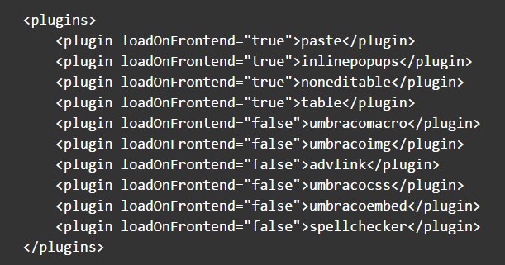
TinyMCE in Umbraco CMS – Plugins
Source: https://our.umbraco.org/documentation/reference/config/tinymceconfig/
Notes:
Inside of the <plugins> node you can find one or more <plugin> nodes. Each one of these nodes defines a plugin which extends the functionality of TinyMce. Below you will find the standard plugins configured in a clean install of Umbraco v6.x.

Slide 7
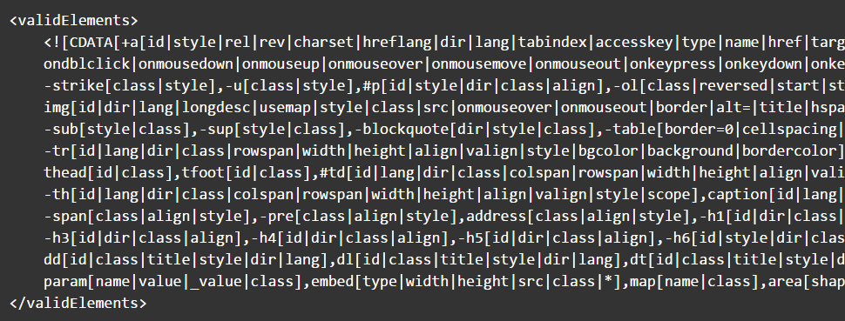
TinyMCE in Umbraco CMS – ValidElements
Source: https://our.umbraco.org/documentation/reference/config/tinymceconfig/
Notes:
The validElements node defines which elements will remain in the edited text when the TinyMce Rich Text Editor (RTE) saves. You can use this to limit the returned HTML to a subset.
This option contains a comma separated list of element conversion chunks. Each chunk contains information about how one element and its attributes should be treated.
Here is an example of the standard valid elements that come with a clean install of Umbraco v6.x.
control characters is taken from the official TinyMce documentation on the topic

Slide 8
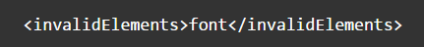
TinyMCE in Umbraco CMS – InvalidElements
Source: https://our.umbraco.org/documentation/reference/config/tinymceconfig/
Notes:
This option should contain a comma separated list of element names to exclude from the saved content. Elements in this list will be removed when your content is saved.

Slide 9
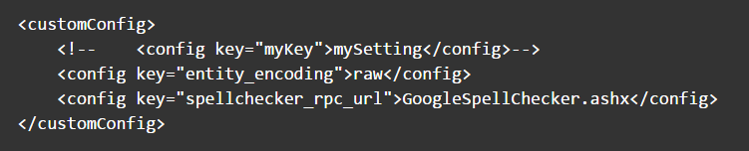
TinyMCE in Umbraco CMS – customConfig
Source: https://our.umbraco.org/documentation/reference/config/tinymceconfig/
Notes:
The customConfig node contains any custom configuration you would like applied to TinyMce when each instance is initialized. For examples of configuration options see the official TinyMce Configuration options documentation.

Slide 10
TinyMCE in Umbraco CMS – Custom Plugin
Add plugin.min.js \Umbraco\lib\tinymce\plugins\pluginname
Register command
Register plugin
Enable plugins in Umbraco Grid settings
Notes:
Gulp task to copy plugin to directory

Slide 11
TinyMCE in Umbraco CMS – Custom Plugin
tinymce core class
create() method
Editor class
dom – DOM instance for the editor
selection – Selection instance for the editor
execCommand()
Selection class
getNode()
Notes:
Create() - Creates a class, subclass or static singleton. More details on this method can be found in the Wiki.
Editor – this class contains the core logic for a TinyMCE editor.
dom - DOM instance for the editor.
execCommand() - Executes a command on the current instance. These commands can be TinyMCE internal commands prefixed with "mce" or they can be build in browser commands such as "Bold". A compleate list of browser commands is available on MSDN or Mozilla.org. This function will dispatch the execCommand function on each plugin, theme or the execcommand_callback option if none of these return true it will handle the command as a internal browser command.
Selection - This class handles text and control selection it's an crossbrowser utility class. Consult the TinyMCE Wiki API for more details and examples on how to use this class.

Slide 12
DEMO

Slide 13
Sources
https://www.tinymce.com
https://our.umbraco.org/documentation/reference/config/tinymceconfig/

Slide 14

Questions?

Slide 15
Thank You

